Slide 1
Review of Chapters 1- 6
We review some important themes from the first 6 chapters
Introduction
Statistics- Set of methods for collecting/analyzing data (the art and science of learning from data). Provides methods for
Design - Planning/Implementing a study
Description – Graphical and numerical methods for summarizing the data
Inference – Methods for making predictions about a population (total set of subjects of interest), based on a sample

Slide 2
2. Sampling and Measurement
Variable – a characteristic that can vary in value among subjects in a sample or a population.
Types of variables
Categorical
Quantitative
Categorical variables can be ordinal (ordered categories) or nominal (unordered categories)
Quantitative variables can be continuous or discrete
Classifications affect the analysis; e.g., for categorical variables we make inferences about proportions and for quantitative variables we make inferences about means (and use t instead of normal dist.)

Slide 3
Randomization – the mechanism for achieving reliable data by reducing potential bias
Simple random sample: In a sample survey, each possible sample of size n has same chance of being selected.
Randomization in a survey used to get a good cross-section of the population. With such probability sampling methods, standard errors are valid for telling us how close sample statistics tend to be to population parameters. (Otherwise, the sampling error is unpredictable.)
Notes:
See text for discussion of random number table to help select

Slide 4
Experimental vs. observational studies
Sample surveys are examples of observational studies (merely observe subjects without any experimental manipulation)
Experimental studies: Researcher assigns subjects to experimental conditions.
  Subjects should be assigned at random to the conditions (“treatments”)
  Randomization “balances” treatment groups with respect to lurking variables that could affect response (e.g., demographic characteristics, SES), makes it easier to assess cause and effect
Notes:
At least for large n

Slide 5
3. Descriptive Statistics
Numerical descriptions of center (mean and median), variability (standard deviation – typical distance from mean), position (quartiles, percentiles)
Bivariate description uses regression/correlation (quantitative variable), contingency table analysis such as chi-squared test (categorical variables), analyzing difference between means (quantitative response and categorical explanatory)
Graphics include histogram, box plot, scatterplot

Slide 6
Mean drawn toward longer tail for skewed distributions, relative to median.
Properties of the standard deviation s:
  s increases with the amount of variation around the mean
  s depends on the units of the data (e.g. measure euro vs $)
  Like mean, affected by outliers
  Empirical rule: If distribution approx. bell-shaped,
  about 68% of data within 1 std. dev. of mean
  about 95% of data within 2 std. dev. of mean
  all or nearly all data within 3 std. dev. of mean

Slide 7
Sample statistics /
Population parameters
We distinguish between summaries of samples (statistics) and summaries of populations (parameters).
Denote statistics by Roman letters, parameters by Greek letters:
Population mean =μ, standard deviation = σ, proportion  are parameters. In practice, parameter values are unknown, we make inferences about their values using sample statistics.

Slide 8
4. Probability Distributions
Probability: With random sampling or a randomized experiment, the probability an observation takes a particular value is the proportion of times that outcome would occur in a long sequence of observations.
Usually corresponds to a population proportion (and thus falls between 0 and 1) for some real or conceptual population.
A probability distribution lists all the possible values and their probabilities (which add to 1.0)

Slide 9
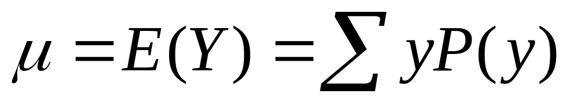
Like frequency dist’s, probability distributions have mean and standard deviation
Standard Deviation - Measure of the “typical” distance of an outcome from the mean, denoted by σ
If a distribution is approximately normal, then:
all or nearly all the distribution falls between
µ - 3σ and µ + 3σ
Probability about 0.68 falls between
µ - σ and µ + σ

Slide 10
Normal distribution
Symmetric, bell-shaped (formula in Exercise 4.56)
Characterized by mean (μ) and standard deviation (σ), representing center and spread
Prob. within any particular number of standard deviations of μ is same for all normal distributions
An individual observation from an approximately normal distribution satisfies:
  Probability 0.68 within 1 standard deviation of mean
  0.95 within 2 standard deviations
  0.997 (virtually all) within 3 standard deviations

Slide 11
Notes about z-scores
z-score represents number of standard deviations that a value falls from mean of dist.
A value y is z = (y - µ)/σ standard deviations from µ
The standard normal distribution is the normal dist with µ = 0, σ = 1 (used as sampling dist. for z test statistics in significance tests)
In inference we use z to count the number of standard errors between a sample estimate and a null hypothesis value.

Slide 12
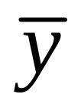
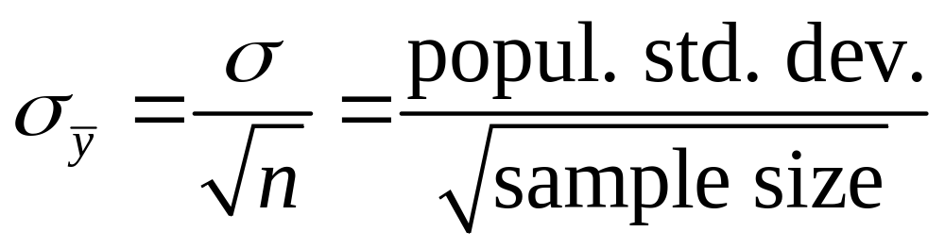
Sampling dist. of sample mean
is a variable, its value varying from sample to sample about population mean µ. Sampling distribution of a statistic is the probability distribution for the possible values of the statistic
Standard deviation of sampling dist of is called the standard error of
For random sampling, the sampling dist of
has mean µ and standard error

Slide 13
Central Limit Theorem: For random sampling with “large” n, sampling dist of sample mean is approximately a normal distribution
Approx. normality applies no matter what the shape of the popul. dist. (Figure p. 93, next page)
How “large” n needs to be depends on skew of population dist, but usually n ≥ 30 sufficient
Can be verified empirically, by simulating with “sampling distribution” applet at www.prenhall.com/agresti. Following figure shows how sampling dist depends on n and shape of population distribution.

Slide 14
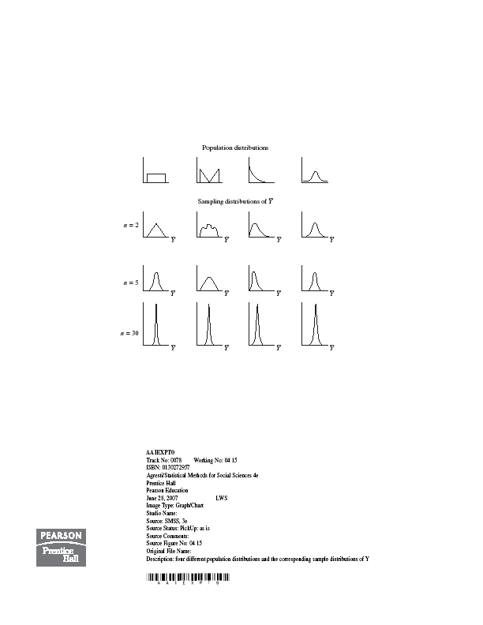

Slide 15
5. Statistical Inference: Estimation
Point estimate: A single statistic value that is the “best guess” for the parameter value (such as sample mean as point estimate of popul. mean)
Interval estimate: An interval of numbers around the point estimate, that has a fixed “confidence level” of containing the parameter value. Called a confidence interval.
(Based on sampling dist. of the point estimate, has form point estimate plus and minus a margin of error that is a z or t score times the standard error)

Slide 16

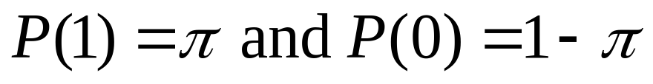
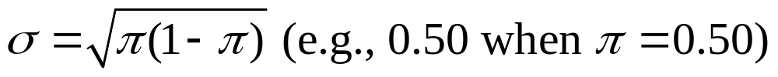
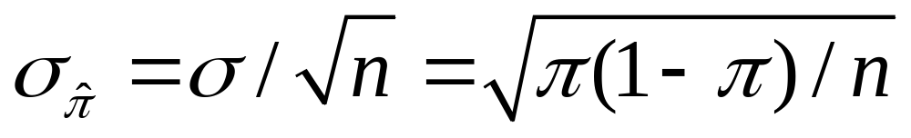
Confidence Interval for a Proportion
(in a particular category)
Sample proportion is a mean when we let y=1 for observation in category of interest, y=0 otherwise
Population prop. is mean µ of prob. dist having
The standard dev. of this prob. dist. is
The standard error of the sample proportion is

Slide 17
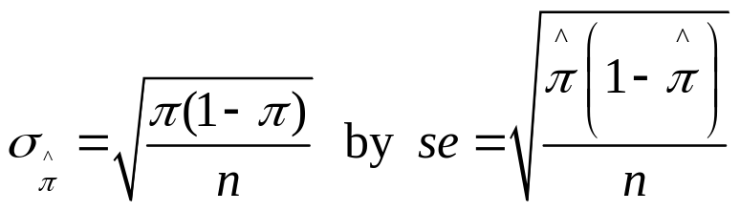

Finding a CI in practice
Complication: The true standard error
itself depends on the unknown parameter!
In practice, we estimate
and then find 95% CI using formula

Slide 18
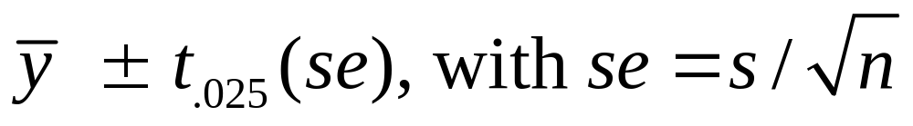
CI for a population mean
For a random sample from a normal population distribution, a 95% CI for µ is
where df = n-1 for the t-score
Normal population assumption ensures sampling dist. has bell shape for any n (Recall figure on p. 93 of text and next page). Method is robust to violation of normal assumption, more so for large n because of CLT.

Slide 19
6. Statistical Inference: Significance Tests
A significance test uses data to summarize evidence about a hypothesis by comparing sample estimates of parameters to values predicted by the hypothesis.
We answer a question such as, “If the hypothesis were true, would it be unlikely to get estimates such as we obtained?”
.

Slide 20
Five Parts of a Significance Test
Assumptions about type of data (quantitative, categorical), sampling method (random), population distribution (binary, normal), sample size (large?)
Hypotheses:
Null hypothesis (H₀): A statement that parameter(s) take specific value(s) (Often: “no effect”)
Alternative hypothesis (H_{a}): states that parameter value(s) in some alternative range of values

Slide 21
Test Statistic: Compares data to what null hypo. H₀ predicts, often by finding the number of standard errors between sample estimate and H₀ value of parameter
P-value (P): A probability measure of evidence about H₀, giving the probability (under presumption that H₀ true) that the test statistic equals observed value or value even more extreme in direction predicted by H_{a}.
  The smaller the P-value, the stronger the evidence against H_{0.}
Conclusion:
  If no decision needed, report and interpret P-value

Slide 22
  If decision needed, select a cutoff point (such as 0.05 or 0.01) and reject H₀ if P-value ≤ that value
  The most widely accepted minimum level is 0.05, and the test is said to be significant at the .05 level if the P-value ≤ 0.05.
  If the P-value is not sufficiently small, we fail to reject H₀ (not necessarily true, but plausible). We should not say “Accept H₀”
  The cutoff point, also called the significance level of the test, is also the prob. of Type I error – i.e., if null true, the probability we will incorrectly reject it.
  Can’t make significance level too small, because then run risk that P(Type II error) = P(do not reject null) when it is false is too large

Slide 23
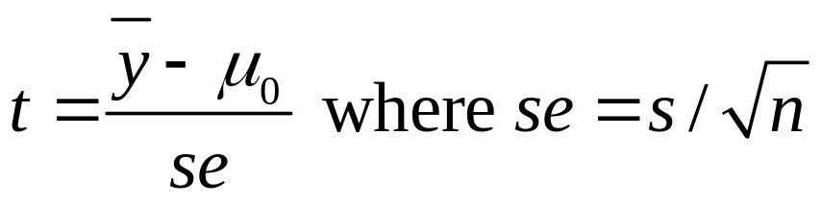
Significance Test for Mean
Assumptions: Randomization, quantitative variable, normal population distribution
Null Hypothesis: H₀: µ = µ₀ where µ₀ is particular value for population mean (typically no effect or change from standard)
Alternative Hypothesis: H_{a}: µ ≠ µ₀ (2-sided alternative includes both > and <, test then robust), or one-sided
Test Statistic: The number of standard errors the sample mean falls from the H₀ value

Slide 24
Significance Test for a Proportion 
Assumptions:
  Categorical variable
  Randomization
  Large sample (but two-sided test is robust for nearly all n)
Hypotheses:
  Null hypothesis: H₀: π = π₀
  Alternative hypothesis: H_{a}: π ≠ π₀ (2-sided)
  H_{a}: π > π₀ H_{a}: π < π₀ (1-sided)
  (choose before getting the data)

Slide 25
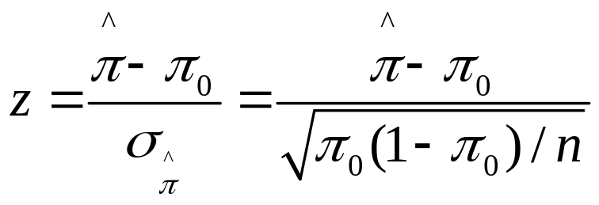
Test statistic:
Note
As in test for mean, test statistic has form
(estimate of parameter – null value)/(standard error)
= no. of standard errors estimate falls from null value
P-value:
  H_{a}: π ≠ π₀ P = 2-tail prob. from standard normal dist.
  H_{a}: π > π₀ P = right-tail prob. from standard normal dist.
  H_{a}: π < π₀ P = left-tail prob. from standard normal dist.
Conclusion: As in test for mean (e.g., reject H₀ if P-value ≤ )

Slide 26
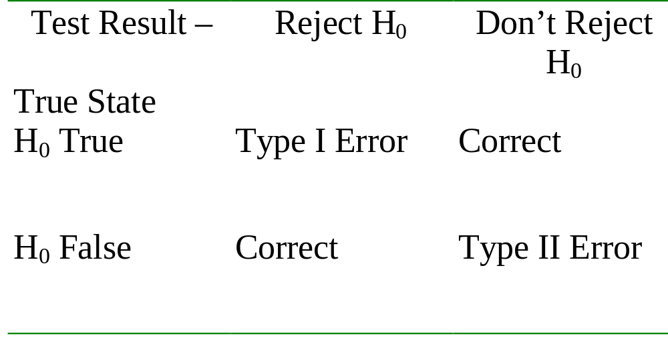
Error Types
Type I Error: Reject H₀ when it is true
Type II Error: Do not reject H₀ when it is false

Slide 27
Limitations of significance tests
Statistical significance does not mean practical significance
Significance tests don’t tell us about the size of the effect (like a CI does)
Some tests may be “statistically significant” just by chance (and some journals only report “significant” results)

